Slide 1
PONTIFÍCIA UNIVERSIDADE CATÓLICA DE SÃO PAULO
CURSO DE ESPECIALIZAÇÃO EM ENGENHARIA DE SOFTWARE
Modelagem de Software
Orientado a Objetos
Modelagem de Software
Orientado a Objetos
Parte 3 – Análise de Modelos de Software
Prof. Maurício Nacib Pontuschka
tuska@pucsp.br

Slide 2
Objetivos
Modelagem de Software Orientado a Objetos
Análise de Modelos de Software
Exercitar a elaboração de modelos de software explorando características sintáticas e semânticas nos diagramas da UML.
Interpretar modelos diagramados com a UML.
Destacar erros de sintaxe e de semântica em diagramas UML mais especificamente em diagramas de casos de uso e diagramas de seqüência de mensagens.
Notes:
Introduce the objectives for this module.

Slide 3

Modelagem de Software Orientado a Objetos
Análise de Modelos de Software
Onde estamos?
Exercício 1 – Jogo da Velha
Alguns Erros de Diagramação
Restrições de Relacionamentos
Exercício 2 – Forum de Notícias
Exercício 3 – Jogo Sudoku
Notes:
The goal of this section is to introduce communication diagrams.

Slide 4
Jogo da Velha
Modelagem de Software Orientado a Objetos
Análise de Modelos de Software
O objetivo deste exercício é realizar a modelagem de um software por meio da UML de forma a implementar o mundialmente conhecido Jogo da Velha.
Notes:
A communication diagram shows how objects interact to perform the behavior of a particular use case or a part of a use case.
Like sequence diagrams, communication diagrams are used by designers to define and clarify the roles of the objects that perform a particular flow of events of a use case. They are the primary source of information used to determine class responsibilities and interfaces.
Because of the communication diagram’s format, they tend to be better suited for analysis activities. Specifically, they tend to be better suited to depict simpler interactions of a smaller number of objects.
As the number of objects and messages grows, the diagram becomes increasingly hard to read. It is also difficult to show additional descriptive information like timing, decision points, or other unstructured information that can be easily added to the notes in a sequence diagram.
Unlike sequence diagrams, communication diagrams emphasize the organization of the objects.
Sequence diagrams, on the other hand, emphasize the time ordering of the messages.

Slide 5
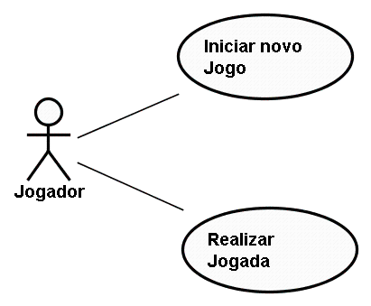
Jogo da Velha
Modelagem de Software Orientado a Objetos
Análise de Modelos de Software
Diagrama de casos de uso
Notes:
A communication diagram shows how objects interact to perform the behavior of a particular use case or a part of a use case.
Like sequence diagrams, communication diagrams are used by designers to define and clarify the roles of the objects that perform a particular flow of events of a use case. They are the primary source of information used to determine class responsibilities and interfaces.
Because of the communication diagram’s format, they tend to be better suited for analysis activities. Specifically, they tend to be better suited to depict simpler interactions of a smaller number of objects.
As the number of objects and messages grows, the diagram becomes increasingly hard to read. It is also difficult to show additional descriptive information like timing, decision points, or other unstructured information that can be easily added to the notes in a sequence diagram.
Unlike sequence diagrams, communication diagrams emphasize the organization of the objects.
Sequence diagrams, on the other hand, emphasize the time ordering of the messages.

Slide 6
Jogo da Velha
Modelagem de Software Orientado a Objetos
Análise de Modelos de Software
Descrição de casos de uso
MN#: Iniciar novo jogo
Ator: Jogador
Pré-Condições: nenhuma
Pós-condições: jogo iniciado
FLUXO PRINCIPAL
1 – O jogador solicita iniciar o jogo
2 – O sistema apresenta um tablado sem nenhuma marca para o início do jogo
Notes:
A communication diagram shows how objects interact to perform the behavior of a particular use case or a part of a use case.
Like sequence diagrams, communication diagrams are used by designers to define and clarify the roles of the objects that perform a particular flow of events of a use case. They are the primary source of information used to determine class responsibilities and interfaces.
Because of the communication diagram’s format, they tend to be better suited for analysis activities. Specifically, they tend to be better suited to depict simpler interactions of a smaller number of objects.
As the number of objects and messages grows, the diagram becomes increasingly hard to read. It is also difficult to show additional descriptive information like timing, decision points, or other unstructured information that can be easily added to the notes in a sequence diagram.
Unlike sequence diagrams, communication diagrams emphasize the organization of the objects.
Sequence diagrams, on the other hand, emphasize the time ordering of the messages.

Slide 7
Jogo da Velha
Modelagem de Software Orientado a Objetos
Análise de Modelos de Software
Descrição de casos de uso
MN#: Realizar jogada
Ator: Jogador
Pré-Condições: jogo iniciado
Pós-condições: jogada realizada
FLUXO PRINCIPAL
1 – O jogador seleciona uma posição do tablado
2 – O sistema verifica se a posição está livre
3 – Caso a posição esteja livre a marca do jogador (O ou X) será colocada na posição solicitada.
4 – O sistema verifica se o jogo terminou.
5 – Se não terminou, o sistema alterna a vez do jogador.
Notes:
A communication diagram shows how objects interact to perform the behavior of a particular use case or a part of a use case.
Like sequence diagrams, communication diagrams are used by designers to define and clarify the roles of the objects that perform a particular flow of events of a use case. They are the primary source of information used to determine class responsibilities and interfaces.
Because of the communication diagram’s format, they tend to be better suited for analysis activities. Specifically, they tend to be better suited to depict simpler interactions of a smaller number of objects.
As the number of objects and messages grows, the diagram becomes increasingly hard to read. It is also difficult to show additional descriptive information like timing, decision points, or other unstructured information that can be easily added to the notes in a sequence diagram.
Unlike sequence diagrams, communication diagrams emphasize the organization of the objects.
Sequence diagrams, on the other hand, emphasize the time ordering of the messages.

Slide 8
Jogo da Velha
Modelagem de Software Orientado a Objetos
Análise de Modelos de Software
Descrição de casos de uso
FLUXO ALTERNATIVO 1
3 – O sistema solicita outra posição ao jogador e o processo volta ao passo 1 do fluxo principal.
FLUXO ALTERNATIVO 2
4 – Se algum jogador alinhou 3 marcas ou não existirem mais posições livres o sistema informa o final do jogo.
Notes:
A communication diagram shows how objects interact to perform the behavior of a particular use case or a part of a use case.
Like sequence diagrams, communication diagrams are used by designers to define and clarify the roles of the objects that perform a particular flow of events of a use case. They are the primary source of information used to determine class responsibilities and interfaces.
Because of the communication diagram’s format, they tend to be better suited for analysis activities. Specifically, they tend to be better suited to depict simpler interactions of a smaller number of objects.
As the number of objects and messages grows, the diagram becomes increasingly hard to read. It is also difficult to show additional descriptive information like timing, decision points, or other unstructured information that can be easily added to the notes in a sequence diagram.
Unlike sequence diagrams, communication diagrams emphasize the organization of the objects.
Sequence diagrams, on the other hand, emphasize the time ordering of the messages.

Slide 9
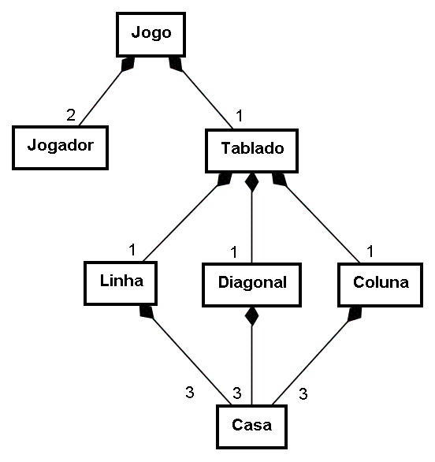
Jogo da Velha
Modelagem de Software Orientado a Objetos
Análise de Modelos de Software
Modelo Conceitual
Notes:
A communication diagram shows how objects interact to perform the behavior of a particular use case or a part of a use case.
Like sequence diagrams, communication diagrams are used by designers to define and clarify the roles of the objects that perform a particular flow of events of a use case. They are the primary source of information used to determine class responsibilities and interfaces.
Because of the communication diagram’s format, they tend to be better suited for analysis activities. Specifically, they tend to be better suited to depict simpler interactions of a smaller number of objects.
As the number of objects and messages grows, the diagram becomes increasingly hard to read. It is also difficult to show additional descriptive information like timing, decision points, or other unstructured information that can be easily added to the notes in a sequence diagram.
Unlike sequence diagrams, communication diagrams emphasize the organization of the objects.
Sequence diagrams, on the other hand, emphasize the time ordering of the messages.

Slide 10
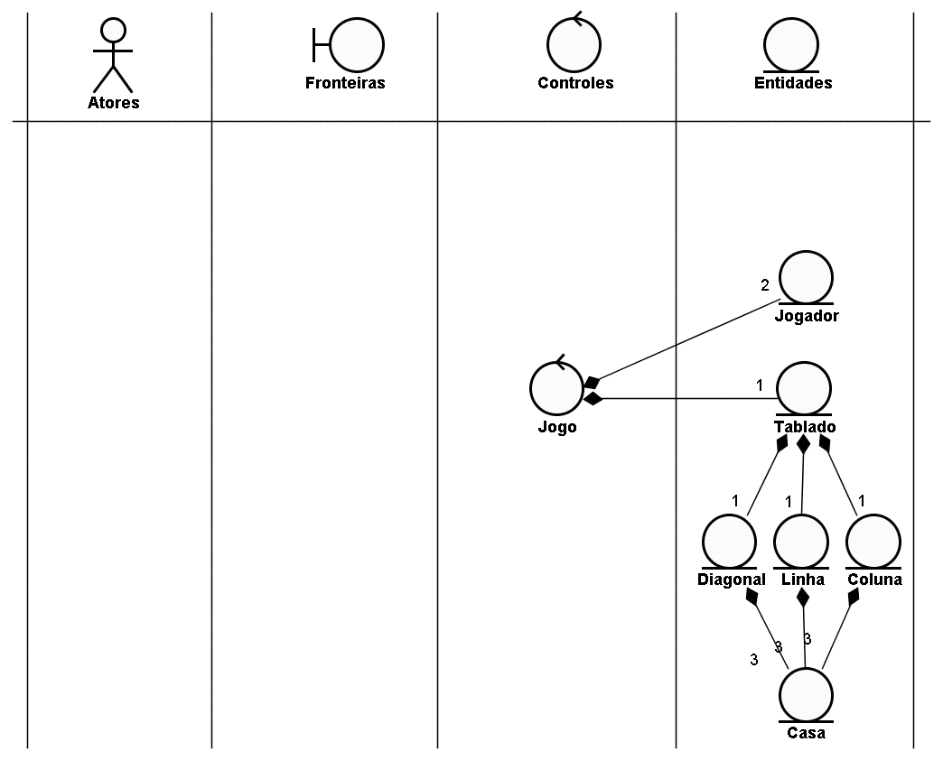
Jogo da Velha
Modelagem de Software Orientado a Objetos
Análise de Modelos de Software
Diagrama de Robustez
Notes:
A communication diagram shows how objects interact to perform the behavior of a particular use case or a part of a use case.
Like sequence diagrams, communication diagrams are used by designers to define and clarify the roles of the objects that perform a particular flow of events of a use case. They are the primary source of information used to determine class responsibilities and interfaces.
Because of the communication diagram’s format, they tend to be better suited for analysis activities. Specifically, they tend to be better suited to depict simpler interactions of a smaller number of objects.
As the number of objects and messages grows, the diagram becomes increasingly hard to read. It is also difficult to show additional descriptive information like timing, decision points, or other unstructured information that can be easily added to the notes in a sequence diagram.
Unlike sequence diagrams, communication diagrams emphasize the organization of the objects.
Sequence diagrams, on the other hand, emphasize the time ordering of the messages.

Slide 11
Jogo da Velha
Modelagem de Software Orientado a Objetos
Análise de Modelos de Software
Diagrama de Robustez
?
Notes:
A communication diagram shows how objects interact to perform the behavior of a particular use case or a part of a use case.
Like sequence diagrams, communication diagrams are used by designers to define and clarify the roles of the objects that perform a particular flow of events of a use case. They are the primary source of information used to determine class responsibilities and interfaces.
Because of the communication diagram’s format, they tend to be better suited for analysis activities. Specifically, they tend to be better suited to depict simpler interactions of a smaller number of objects.
As the number of objects and messages grows, the diagram becomes increasingly hard to read. It is also difficult to show additional descriptive information like timing, decision points, or other unstructured information that can be easily added to the notes in a sequence diagram.
Unlike sequence diagrams, communication diagrams emphasize the organization of the objects.
Sequence diagrams, on the other hand, emphasize the time ordering of the messages.

Slide 12
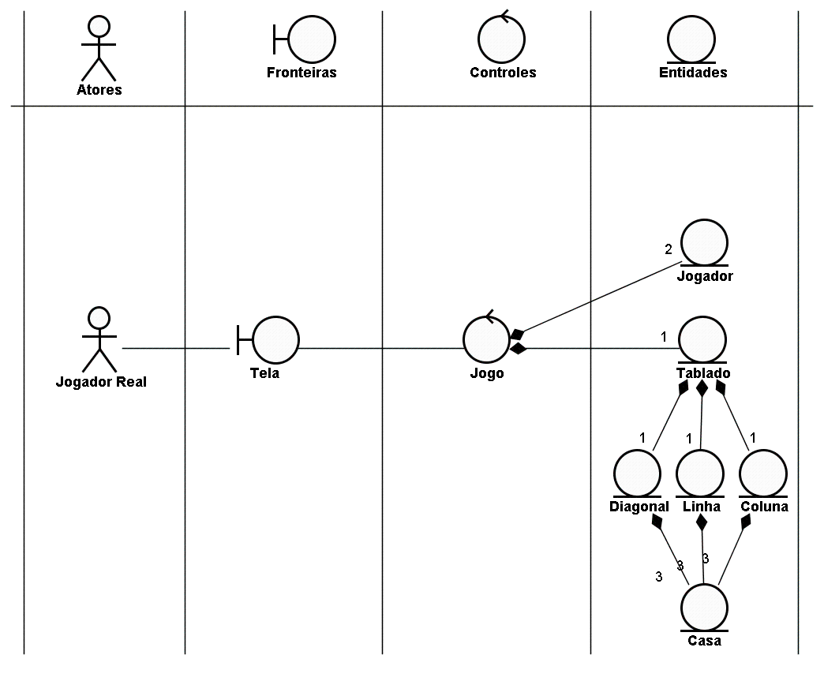
Jogo da Velha
Modelagem de Software Orientado a Objetos
Análise de Modelos de Software
Diagrama de Robustez
Notes:
A communication diagram shows how objects interact to perform the behavior of a particular use case or a part of a use case.
Like sequence diagrams, communication diagrams are used by designers to define and clarify the roles of the objects that perform a particular flow of events of a use case. They are the primary source of information used to determine class responsibilities and interfaces.
Because of the communication diagram’s format, they tend to be better suited for analysis activities. Specifically, they tend to be better suited to depict simpler interactions of a smaller number of objects.
As the number of objects and messages grows, the diagram becomes increasingly hard to read. It is also difficult to show additional descriptive information like timing, decision points, or other unstructured information that can be easily added to the notes in a sequence diagram.
Unlike sequence diagrams, communication diagrams emphasize the organization of the objects.
Sequence diagrams, on the other hand, emphasize the time ordering of the messages.

Slide 13
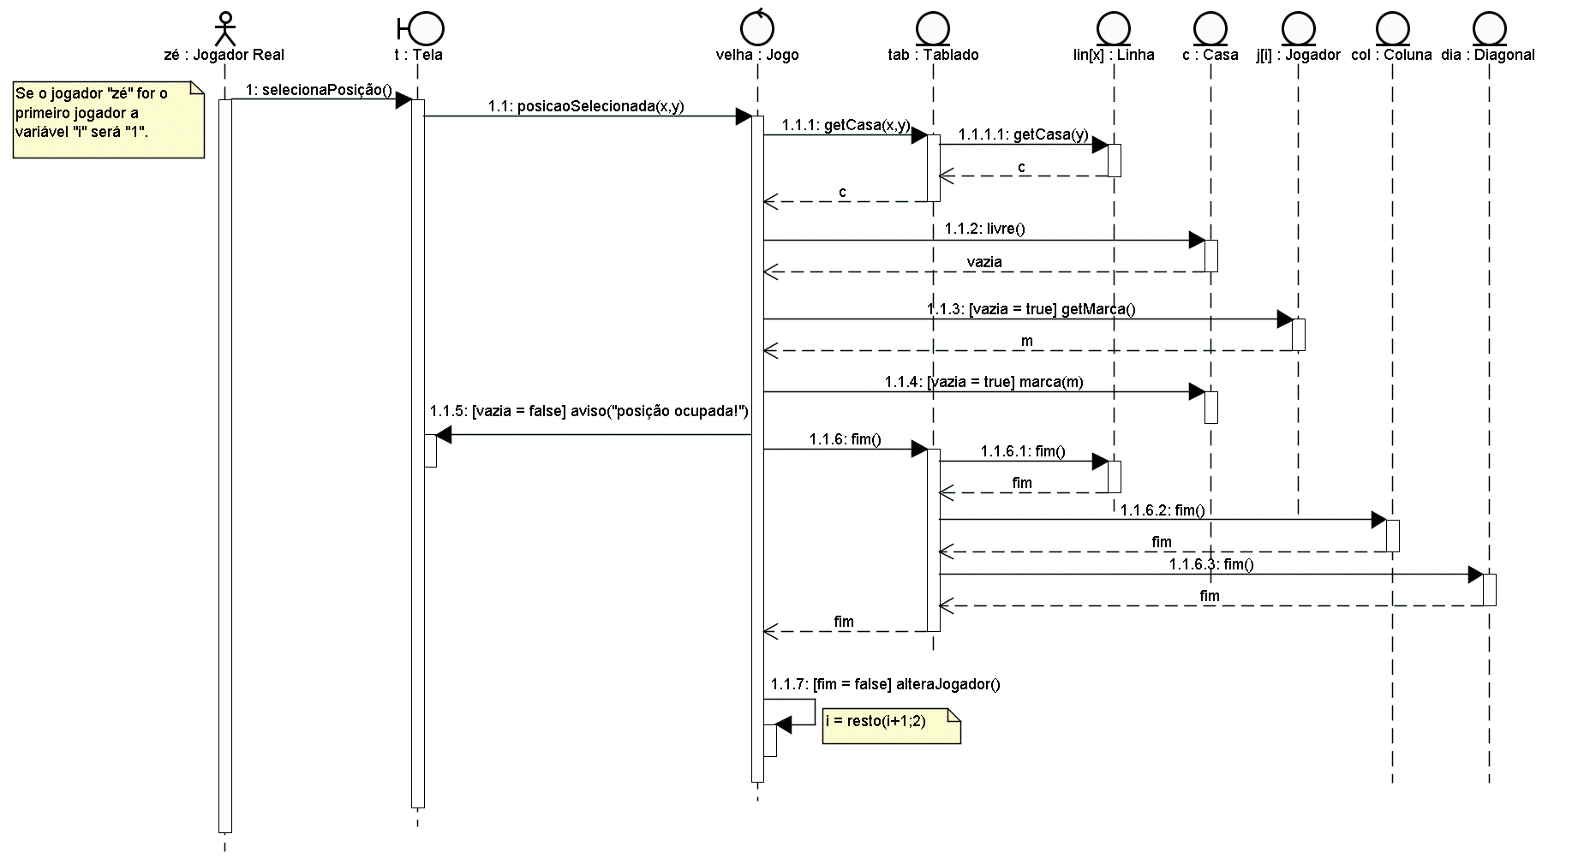
Jogo da Velha
Modelagem de Software Orientado a Objetos
Análise de Modelos de Software
Diagrama de Seqüência de Mensagens
Notes:
A communication diagram shows how objects interact to perform the behavior of a particular use case or a part of a use case.
Like sequence diagrams, communication diagrams are used by designers to define and clarify the roles of the objects that perform a particular flow of events of a use case. They are the primary source of information used to determine class responsibilities and interfaces.
Because of the communication diagram’s format, they tend to be better suited for analysis activities. Specifically, they tend to be better suited to depict simpler interactions of a smaller number of objects.
As the number of objects and messages grows, the diagram becomes increasingly hard to read. It is also difficult to show additional descriptive information like timing, decision points, or other unstructured information that can be easily added to the notes in a sequence diagram.
Unlike sequence diagrams, communication diagrams emphasize the organization of the objects.
Sequence diagrams, on the other hand, emphasize the time ordering of the messages.

Slide 14
Modelagem de Software Orientado a Objetos
Análise de Modelos de Software
Onde estamos?
Exercício 1 – Jogo da Velha
Alguns erros de Diagramação
Restrições de Relacionamentos
Exercício 2 – Forum de Notícias
Exercício 3 – Jogo Sudoku
Notes:
The goal of this section is to introduce communication diagrams.

Slide 15
Erro de sincronismo de processos em diagramas de seqüência de mensagens
Modelagem de Software Orientado a Objetos
Análise de Modelos de Software
T:Tela
Qual o erro presente no diagrama ao lado?
joão:Desenhista
marcar()
Notes:
A communication diagram shows how objects interact to perform the behavior of a particular use case or a part of a use case.
Like sequence diagrams, communication diagrams are used by designers to define and clarify the roles of the objects that perform a particular flow of events of a use case. They are the primary source of information used to determine class responsibilities and interfaces.
Because of the communication diagram’s format, they tend to be better suited for analysis activities. Specifically, they tend to be better suited to depict simpler interactions of a smaller number of objects.
As the number of objects and messages grows, the diagram becomes increasingly hard to read. It is also difficult to show additional descriptive information like timing, decision points, or other unstructured information that can be easily added to the notes in a sequence diagram.
Unlike sequence diagrams, communication diagrams emphasize the organization of the objects.
Sequence diagrams, on the other hand, emphasize the time ordering of the messages.

Slide 16
Erro de sincronismo de processos em diagramas de seqüência de mensagens
Modelagem de Software Orientado a Objetos
Análise de Modelos de Software
T:Tela
Qual o erro presente no diagrama ao lado?
joão:Desenhista
marcar()
O processo marcar() é iniciado por outro processo e deve estar aninhado em relação a ele. Note que neste diagrama o processo marcar() termina depois do processo que o chamou.
Notes:
A communication diagram shows how objects interact to perform the behavior of a particular use case or a part of a use case.
Like sequence diagrams, communication diagrams are used by designers to define and clarify the roles of the objects that perform a particular flow of events of a use case. They are the primary source of information used to determine class responsibilities and interfaces.
Because of the communication diagram’s format, they tend to be better suited for analysis activities. Specifically, they tend to be better suited to depict simpler interactions of a smaller number of objects.
As the number of objects and messages grows, the diagram becomes increasingly hard to read. It is also difficult to show additional descriptive information like timing, decision points, or other unstructured information that can be easily added to the notes in a sequence diagram.
Unlike sequence diagrams, communication diagrams emphasize the organization of the objects.
Sequence diagrams, on the other hand, emphasize the time ordering of the messages.

Slide 17
Erro de sincronismo de processos em diagramas de seqüência de mensagens
Modelagem de Software Orientado a Objetos
Análise de Modelos de Software
T:Tela
Como resolver o problema?
joão:Desenhista
marcar()
Notes:
A communication diagram shows how objects interact to perform the behavior of a particular use case or a part of a use case.
Like sequence diagrams, communication diagrams are used by designers to define and clarify the roles of the objects that perform a particular flow of events of a use case. They are the primary source of information used to determine class responsibilities and interfaces.
Because of the communication diagram’s format, they tend to be better suited for analysis activities. Specifically, they tend to be better suited to depict simpler interactions of a smaller number of objects.
As the number of objects and messages grows, the diagram becomes increasingly hard to read. It is also difficult to show additional descriptive information like timing, decision points, or other unstructured information that can be easily added to the notes in a sequence diagram.
Unlike sequence diagrams, communication diagrams emphasize the organization of the objects.
Sequence diagrams, on the other hand, emphasize the time ordering of the messages.

Slide 18
Erro de sincronismo de processos em diagramas de seqüência de mensagens
Modelagem de Software Orientado a Objetos
Análise de Modelos de Software
T:Tela
Como resolver o problema?
1) Se o processo marcar() necessariamente deve finalizar após a finalização do processo que o chamou, isto significa que a chamada deveria ser assíncrona!
joão:Desenhista
marcar()
Notes:
A communication diagram shows how objects interact to perform the behavior of a particular use case or a part of a use case.
Like sequence diagrams, communication diagrams are used by designers to define and clarify the roles of the objects that perform a particular flow of events of a use case. They are the primary source of information used to determine class responsibilities and interfaces.
Because of the communication diagram’s format, they tend to be better suited for analysis activities. Specifically, they tend to be better suited to depict simpler interactions of a smaller number of objects.
As the number of objects and messages grows, the diagram becomes increasingly hard to read. It is also difficult to show additional descriptive information like timing, decision points, or other unstructured information that can be easily added to the notes in a sequence diagram.
Unlike sequence diagrams, communication diagrams emphasize the organization of the objects.
Sequence diagrams, on the other hand, emphasize the time ordering of the messages.

Slide 19
Erro de sincronismo de processos em diagramas de seqüência de mensagens
Modelagem de Software Orientado a Objetos
Análise de Modelos de Software
T:Tela
Como resolver o problema?
2) Normalmente o problema está em definir realmente que o processo marcar() deve terminar antes do processo que o chamou. Portanto devemos prolongar o tempo de execução do processo que emitiu a mensagem até que todas as mensagens que ele chamou tenham finalizado.
joão:Desenhista
marcar()
Notes:
A communication diagram shows how objects interact to perform the behavior of a particular use case or a part of a use case.
Like sequence diagrams, communication diagrams are used by designers to define and clarify the roles of the objects that perform a particular flow of events of a use case. They are the primary source of information used to determine class responsibilities and interfaces.
Because of the communication diagram’s format, they tend to be better suited for analysis activities. Specifically, they tend to be better suited to depict simpler interactions of a smaller number of objects.
As the number of objects and messages grows, the diagram becomes increasingly hard to read. It is also difficult to show additional descriptive information like timing, decision points, or other unstructured information that can be easily added to the notes in a sequence diagram.
Unlike sequence diagrams, communication diagrams emphasize the organization of the objects.
Sequence diagrams, on the other hand, emphasize the time ordering of the messages.

Slide 20
Erro na especificação de loops ou blocos restritivos
Modelagem de Software Orientado a Objetos
Análise de Modelos de Software
T:Tela
Qual o erro presente no diagrama ao lado?
joão:Desenhista
Loop
marcar()
Notes:
A communication diagram shows how objects interact to perform the behavior of a particular use case or a part of a use case.
Like sequence diagrams, communication diagrams are used by designers to define and clarify the roles of the objects that perform a particular flow of events of a use case. They are the primary source of information used to determine class responsibilities and interfaces.
Because of the communication diagram’s format, they tend to be better suited for analysis activities. Specifically, they tend to be better suited to depict simpler interactions of a smaller number of objects.
As the number of objects and messages grows, the diagram becomes increasingly hard to read. It is also difficult to show additional descriptive information like timing, decision points, or other unstructured information that can be easily added to the notes in a sequence diagram.
Unlike sequence diagrams, communication diagrams emphasize the organization of the objects.
Sequence diagrams, on the other hand, emphasize the time ordering of the messages.

Slide 21
Erro na especificação de loops ou blocos restritivos
Modelagem de Software Orientado a Objetos
Análise de Modelos de Software
T:Tela
Qual o erro presente no diagrama ao lado?
Note que o bloco restritivo inicia no meio de um processo que é encerrado dentro do próprio bloco. Um processo não pode finalizar várias vezes!
joão:Desenhista
Loop
marcar()
Notes:
A communication diagram shows how objects interact to perform the behavior of a particular use case or a part of a use case.
Like sequence diagrams, communication diagrams are used by designers to define and clarify the roles of the objects that perform a particular flow of events of a use case. They are the primary source of information used to determine class responsibilities and interfaces.
Because of the communication diagram’s format, they tend to be better suited for analysis activities. Specifically, they tend to be better suited to depict simpler interactions of a smaller number of objects.
As the number of objects and messages grows, the diagram becomes increasingly hard to read. It is also difficult to show additional descriptive information like timing, decision points, or other unstructured information that can be easily added to the notes in a sequence diagram.
Unlike sequence diagrams, communication diagrams emphasize the organization of the objects.
Sequence diagrams, on the other hand, emphasize the time ordering of the messages.

Slide 22
Erro na especificação de loops ou blocos restritivos
Modelagem de Software Orientado a Objetos
Análise de Modelos de Software
T:Tela
Como resolver o problema?
joão:Desenhista
Loop
marcar()
Notes:
A communication diagram shows how objects interact to perform the behavior of a particular use case or a part of a use case.
Like sequence diagrams, communication diagrams are used by designers to define and clarify the roles of the objects that perform a particular flow of events of a use case. They are the primary source of information used to determine class responsibilities and interfaces.
Because of the communication diagram’s format, they tend to be better suited for analysis activities. Specifically, they tend to be better suited to depict simpler interactions of a smaller number of objects.
As the number of objects and messages grows, the diagram becomes increasingly hard to read. It is also difficult to show additional descriptive information like timing, decision points, or other unstructured information that can be easily added to the notes in a sequence diagram.
Unlike sequence diagrams, communication diagrams emphasize the organization of the objects.
Sequence diagrams, on the other hand, emphasize the time ordering of the messages.

Slide 23
Erro na especificação de loops ou blocos restritivos
Modelagem de Software Orientado a Objetos
Análise de Modelos de Software
T:Tela
Como resolver o problema?
Devemos garantir que o início e o término do bloco de restrição ou estejam inteiramente dentro de um processo ou os processos estejam inteiramente dentro do bloco.
joão:Desenhista
Loop
marcar()
Notes:
A communication diagram shows how objects interact to perform the behavior of a particular use case or a part of a use case.
Like sequence diagrams, communication diagrams are used by designers to define and clarify the roles of the objects that perform a particular flow of events of a use case. They are the primary source of information used to determine class responsibilities and interfaces.
Because of the communication diagram’s format, they tend to be better suited for analysis activities. Specifically, they tend to be better suited to depict simpler interactions of a smaller number of objects.
As the number of objects and messages grows, the diagram becomes increasingly hard to read. It is also difficult to show additional descriptive information like timing, decision points, or other unstructured information that can be easily added to the notes in a sequence diagram.
Unlike sequence diagrams, communication diagrams emphasize the organization of the objects.
Sequence diagrams, on the other hand, emphasize the time ordering of the messages.

Slide 24
Erro na especificação de loops ou blocos restritivos
Modelagem de Software Orientado a Objetos
Análise de Modelos de Software
T:Tela
Como resolver o problema?
Devemos garantir que o início e o término do bloco de restrição ou estejam inteiramente dentro de um processo ou os processos estejam inteiramente dentro do bloco.
joão:Desenhista
Loop
marcar()
Notes:
A communication diagram shows how objects interact to perform the behavior of a particular use case or a part of a use case.
Like sequence diagrams, communication diagrams are used by designers to define and clarify the roles of the objects that perform a particular flow of events of a use case. They are the primary source of information used to determine class responsibilities and interfaces.
Because of the communication diagram’s format, they tend to be better suited for analysis activities. Specifically, they tend to be better suited to depict simpler interactions of a smaller number of objects.
As the number of objects and messages grows, the diagram becomes increasingly hard to read. It is also difficult to show additional descriptive information like timing, decision points, or other unstructured information that can be easily added to the notes in a sequence diagram.
Unlike sequence diagrams, communication diagrams emphasize the organization of the objects.
Sequence diagrams, on the other hand, emphasize the time ordering of the messages.

Slide 25
Erro no retorno de mensagens
Modelagem de Software Orientado a Objetos
Análise de Modelos de Software
T:Tela
T:TracaCirculo
Qual o erro presente no diagrama ao lado?
joão:Desenhista
marcar()
tracar()
ok
Notes:
A communication diagram shows how objects interact to perform the behavior of a particular use case or a part of a use case.
Like sequence diagrams, communication diagrams are used by designers to define and clarify the roles of the objects that perform a particular flow of events of a use case. They are the primary source of information used to determine class responsibilities and interfaces.
Because of the communication diagram’s format, they tend to be better suited for analysis activities. Specifically, they tend to be better suited to depict simpler interactions of a smaller number of objects.
As the number of objects and messages grows, the diagram becomes increasingly hard to read. It is also difficult to show additional descriptive information like timing, decision points, or other unstructured information that can be easily added to the notes in a sequence diagram.
Unlike sequence diagrams, communication diagrams emphasize the organization of the objects.
Sequence diagrams, on the other hand, emphasize the time ordering of the messages.

Slide 26
Erro no retorno de mensagens
Modelagem de Software Orientado a Objetos
Análise de Modelos de Software
T:Tela
T:TracaCirculo
Qual o erro presente no diagrama ao lado?
O retorno do processo é enviado a outro objeto que não o que enviou a mensagem.
joão:Desenhista
marcar()
tracar()
ok
Notes:
A communication diagram shows how objects interact to perform the behavior of a particular use case or a part of a use case.
Like sequence diagrams, communication diagrams are used by designers to define and clarify the roles of the objects that perform a particular flow of events of a use case. They are the primary source of information used to determine class responsibilities and interfaces.
Because of the communication diagram’s format, they tend to be better suited for analysis activities. Specifically, they tend to be better suited to depict simpler interactions of a smaller number of objects.
As the number of objects and messages grows, the diagram becomes increasingly hard to read. It is also difficult to show additional descriptive information like timing, decision points, or other unstructured information that can be easily added to the notes in a sequence diagram.
Unlike sequence diagrams, communication diagrams emphasize the organization of the objects.
Sequence diagrams, on the other hand, emphasize the time ordering of the messages.

Slide 27
Erro no retorno de mensagens
Modelagem de Software Orientado a Objetos
Análise de Modelos de Software
T:Tela
T:TracaCirculo
Como resolver o problema?
O retorno remete a resposta para o objeto que o chamou e este objeto retransmite a mensagem.
joão:Desenhista
marcar()
tracar()
ok
ok
Notes:
A communication diagram shows how objects interact to perform the behavior of a particular use case or a part of a use case.
Like sequence diagrams, communication diagrams are used by designers to define and clarify the roles of the objects that perform a particular flow of events of a use case. They are the primary source of information used to determine class responsibilities and interfaces.
Because of the communication diagram’s format, they tend to be better suited for analysis activities. Specifically, they tend to be better suited to depict simpler interactions of a smaller number of objects.
As the number of objects and messages grows, the diagram becomes increasingly hard to read. It is also difficult to show additional descriptive information like timing, decision points, or other unstructured information that can be easily added to the notes in a sequence diagram.
Unlike sequence diagrams, communication diagrams emphasize the organization of the objects.
Sequence diagrams, on the other hand, emphasize the time ordering of the messages.

Slide 28
Erro no retorno de mensagens
Modelagem de Software Orientado a Objetos
Análise de Modelos de Software
T:Tela
T:TracaCirculo
Como resolver o problema?
Outra forma é ao invés de enviar a resposta através do retorno, envie uma nova mensagem.
joão:Desenhista
marcar()
tracar()
ok
Notes:
A communication diagram shows how objects interact to perform the behavior of a particular use case or a part of a use case.
Like sequence diagrams, communication diagrams are used by designers to define and clarify the roles of the objects that perform a particular flow of events of a use case. They are the primary source of information used to determine class responsibilities and interfaces.
Because of the communication diagram’s format, they tend to be better suited for analysis activities. Specifically, they tend to be better suited to depict simpler interactions of a smaller number of objects.
As the number of objects and messages grows, the diagram becomes increasingly hard to read. It is also difficult to show additional descriptive information like timing, decision points, or other unstructured information that can be easily added to the notes in a sequence diagram.
Unlike sequence diagrams, communication diagrams emphasize the organization of the objects.
Sequence diagrams, on the other hand, emphasize the time ordering of the messages.

Slide 29
Modelagem de Software Orientado a Objetos
Análise de Modelos de Software
Onde estamos?
Exercício 1 – Jogo da Velha
Alguns Erros de Diagramação
Restrições de Relacionamentos
Exercício 2 – Forum de Notícias
Exercício 3 – Jogo Sudoku
Notes:
The goal of this section is to introduce communication diagrams.

Slide 30
Semântica em relacionamento de classes
Modelagem de Software Orientado a Objetos
Análise de Modelos de Software
Classe1
Classe2
Associação
Classe1
Classe2
Agregação
Classe1
Classe2
Composição
Classe1
Classe2
Generalização
Notes:
A communication diagram shows how objects interact to perform the behavior of a particular use case or a part of a use case.
Like sequence diagrams, communication diagrams are used by designers to define and clarify the roles of the objects that perform a particular flow of events of a use case. They are the primary source of information used to determine class responsibilities and interfaces.
Because of the communication diagram’s format, they tend to be better suited for analysis activities. Specifically, they tend to be better suited to depict simpler interactions of a smaller number of objects.
As the number of objects and messages grows, the diagram becomes increasingly hard to read. It is also difficult to show additional descriptive information like timing, decision points, or other unstructured information that can be easily added to the notes in a sequence diagram.
Unlike sequence diagrams, communication diagrams emphasize the organization of the objects.
Sequence diagrams, on the other hand, emphasize the time ordering of the messages.

Slide 31
Semântica em relacionamento de classes
Modelagem de Software Orientado a Objetos
Análise de Modelos de Software
Estudante
Secretária
Associação
As classes vinculadas por uma associação podem trocar mensagens.
Exemplo:
Estudante fala com a Secretária
Notes:
A communication diagram shows how objects interact to perform the behavior of a particular use case or a part of a use case.
Like sequence diagrams, communication diagrams are used by designers to define and clarify the roles of the objects that perform a particular flow of events of a use case. They are the primary source of information used to determine class responsibilities and interfaces.
Because of the communication diagram’s format, they tend to be better suited for analysis activities. Specifically, they tend to be better suited to depict simpler interactions of a smaller number of objects.
As the number of objects and messages grows, the diagram becomes increasingly hard to read. It is also difficult to show additional descriptive information like timing, decision points, or other unstructured information that can be easily added to the notes in a sequence diagram.
Unlike sequence diagrams, communication diagrams emphasize the organization of the objects.
Sequence diagrams, on the other hand, emphasize the time ordering of the messages.

Slide 32
Semântica em relacionamento de classes
Modelagem de Software Orientado a Objetos
Análise de Modelos de Software
Meias
Gaveta
Agregação
Um relacionamento de agregação indica que objetos de uma determinada classe possui objetos de outra classe.
Exemplo:
Gaveta possui Meias
Notes:
A communication diagram shows how objects interact to perform the behavior of a particular use case or a part of a use case.
Like sequence diagrams, communication diagrams are used by designers to define and clarify the roles of the objects that perform a particular flow of events of a use case. They are the primary source of information used to determine class responsibilities and interfaces.
Because of the communication diagram’s format, they tend to be better suited for analysis activities. Specifically, they tend to be better suited to depict simpler interactions of a smaller number of objects.
As the number of objects and messages grows, the diagram becomes increasingly hard to read. It is also difficult to show additional descriptive information like timing, decision points, or other unstructured information that can be easily added to the notes in a sequence diagram.
Unlike sequence diagrams, communication diagrams emphasize the organization of the objects.
Sequence diagrams, on the other hand, emphasize the time ordering of the messages.

Slide 33
Semântica em relacionamento de classes
Modelagem de Software Orientado a Objetos
Análise de Modelos de Software
Assento
Cadeira
Composição
Um relacionamento de composição indica que o objetos de uma determinada classe são partes de objetos de uma outra classe.
Exemplo:
Assento é parte de uma Cadeira
Notes:
A communication diagram shows how objects interact to perform the behavior of a particular use case or a part of a use case.
Like sequence diagrams, communication diagrams are used by designers to define and clarify the roles of the objects that perform a particular flow of events of a use case. They are the primary source of information used to determine class responsibilities and interfaces.
Because of the communication diagram’s format, they tend to be better suited for analysis activities. Specifically, they tend to be better suited to depict simpler interactions of a smaller number of objects.
As the number of objects and messages grows, the diagram becomes increasingly hard to read. It is also difficult to show additional descriptive information like timing, decision points, or other unstructured information that can be easily added to the notes in a sequence diagram.
Unlike sequence diagrams, communication diagrams emphasize the organization of the objects.
Sequence diagrams, on the other hand, emphasize the time ordering of the messages.

Slide 34
Semântica em relacionamento de classes
Modelagem de Software Orientado a Objetos
Análise de Modelos de Software
Pássaro
Animal
Generalização
Um relacionamento de generalização indica uma relação de herança entre classes e especifica que o objetos de uma determinada classe são objetos de uma outra classe.
Exemplo:
Pássaro é um Animal
Notes:
A communication diagram shows how objects interact to perform the behavior of a particular use case or a part of a use case.
Like sequence diagrams, communication diagrams are used by designers to define and clarify the roles of the objects that perform a particular flow of events of a use case. They are the primary source of information used to determine class responsibilities and interfaces.
Because of the communication diagram’s format, they tend to be better suited for analysis activities. Specifically, they tend to be better suited to depict simpler interactions of a smaller number of objects.
As the number of objects and messages grows, the diagram becomes increasingly hard to read. It is also difficult to show additional descriptive information like timing, decision points, or other unstructured information that can be easily added to the notes in a sequence diagram.
Unlike sequence diagrams, communication diagrams emphasize the organization of the objects.
Sequence diagrams, on the other hand, emphasize the time ordering of the messages.

Slide 35
Restrições em relacionamentos
Modelagem de Software Orientado a Objetos
Análise de Modelos de Software
Além de especificar os relacionamentos, nós podemos especificar restrições em relacionamentos.
Repare as afirmações:
“Uma gaveta pode conter meias”
“Um menino pode ser mordido por cachorros”
Como podemos modelar estas afirmações? Imaginaremos que o relacionamento entre gaveta e meia seria “guardar” e de menino com cachorro seria “morder”.
Notes:
A communication diagram shows how objects interact to perform the behavior of a particular use case or a part of a use case.
Like sequence diagrams, communication diagrams are used by designers to define and clarify the roles of the objects that perform a particular flow of events of a use case. They are the primary source of information used to determine class responsibilities and interfaces.
Because of the communication diagram’s format, they tend to be better suited for analysis activities. Specifically, they tend to be better suited to depict simpler interactions of a smaller number of objects.
As the number of objects and messages grows, the diagram becomes increasingly hard to read. It is also difficult to show additional descriptive information like timing, decision points, or other unstructured information that can be easily added to the notes in a sequence diagram.
Unlike sequence diagrams, communication diagrams emphasize the organization of the objects.
Sequence diagrams, on the other hand, emphasize the time ordering of the messages.

Slide 36
Restrições em relacionamentos
Modelagem de Software Orientado a Objetos
Análise de Modelos de Software
guarda
mordida
Meias
0..*
Gaveta
Cachorro
0..*
Menino
Se as multiplicidades dos relacionamentos em ambos os casos forem 5, quantas meias eu estaria referenciando? E quantos cachorros?
Os modelos se diferenciam pois no caso das meias estamos querendo modelar “cardinalidade”que referencia diretamente ao número de meias guardadas e no caso dos cachorros “multiplicidade” o que referencia o número de mordidas e não de cachorros.
Notes:
A communication diagram shows how objects interact to perform the behavior of a particular use case or a part of a use case.
Like sequence diagrams, communication diagrams are used by designers to define and clarify the roles of the objects that perform a particular flow of events of a use case. They are the primary source of information used to determine class responsibilities and interfaces.
Because of the communication diagram’s format, they tend to be better suited for analysis activities. Specifically, they tend to be better suited to depict simpler interactions of a smaller number of objects.
As the number of objects and messages grows, the diagram becomes increasingly hard to read. It is also difficult to show additional descriptive information like timing, decision points, or other unstructured information that can be easily added to the notes in a sequence diagram.
Unlike sequence diagrams, communication diagrams emphasize the organization of the objects.
Sequence diagrams, on the other hand, emphasize the time ordering of the messages.

Slide 37
Restrições em relacionamentos
Modelagem de Software Orientado a Objetos
Análise de Modelos de Software
guarda
mordida
Meias
5
Gaveta
Cachorro
5
Menino
No caso das meias, o número de meias é o próprio número de relacionamentos, no caso do cachorro, o número de cachorros pode ser menor ou igual ao número de relacionamentos (mordidas).
As restrições de relacionamento que podemos utilizar para expressar estes tipos de relacionamento são: SET e BAG.
Notes:
A communication diagram shows how objects interact to perform the behavior of a particular use case or a part of a use case.
Like sequence diagrams, communication diagrams are used by designers to define and clarify the roles of the objects that perform a particular flow of events of a use case. They are the primary source of information used to determine class responsibilities and interfaces.
Because of the communication diagram’s format, they tend to be better suited for analysis activities. Specifically, they tend to be better suited to depict simpler interactions of a smaller number of objects.
As the number of objects and messages grows, the diagram becomes increasingly hard to read. It is also difficult to show additional descriptive information like timing, decision points, or other unstructured information that can be easily added to the notes in a sequence diagram.
Unlike sequence diagrams, communication diagrams emphasize the organization of the objects.
Sequence diagrams, on the other hand, emphasize the time ordering of the messages.

Slide 38
Restrições em relacionamentos
Modelagem de Software Orientado a Objetos
Análise de Modelos de Software
guarda
{set}
mordida
{bag}
Meias
5
Gaveta
Cachorro
5
Menino
SET: Indica conjunto e portanto não admite mais de um relacionamento com um mesmo objeto.
BAG: Indica irrestrição, isto é, nada se diz a respeito do número de objetos. É possível que todas as mordidas tenham sido provenientes de um mesmo cachorro.
Notes:
A communication diagram shows how objects interact to perform the behavior of a particular use case or a part of a use case.
Like sequence diagrams, communication diagrams are used by designers to define and clarify the roles of the objects that perform a particular flow of events of a use case. They are the primary source of information used to determine class responsibilities and interfaces.
Because of the communication diagram’s format, they tend to be better suited for analysis activities. Specifically, they tend to be better suited to depict simpler interactions of a smaller number of objects.
As the number of objects and messages grows, the diagram becomes increasingly hard to read. It is also difficult to show additional descriptive information like timing, decision points, or other unstructured information that can be easily added to the notes in a sequence diagram.
Unlike sequence diagrams, communication diagrams emphasize the organization of the objects.
Sequence diagrams, on the other hand, emphasize the time ordering of the messages.

Slide 39
Modelagem de Software Orientado a Objetos
Análise de Modelos de Software
Onde estamos?
Exercício 1 – Jogo da Velha
Alguns Erros de Diagramação
Restrições em Relacionamentos
Exercício 2 – Forum de Notícias
Exercício 3 – Jogo Sudoku
Notes:
The goal of this section is to introduce communication diagrams.

Slide 40
Forum de Notícias
Modelagem de Software Orientado a Objetos
Análise de Modelos de Software
Elabore um fórum de notícias de forma que seja possível um usuário cadastrar questões, consultar as questões, responder questões e consultar respostas.
Notes:
A communication diagram shows how objects interact to perform the behavior of a particular use case or a part of a use case.
Like sequence diagrams, communication diagrams are used by designers to define and clarify the roles of the objects that perform a particular flow of events of a use case. They are the primary source of information used to determine class responsibilities and interfaces.
Because of the communication diagram’s format, they tend to be better suited for analysis activities. Specifically, they tend to be better suited to depict simpler interactions of a smaller number of objects.
As the number of objects and messages grows, the diagram becomes increasingly hard to read. It is also difficult to show additional descriptive information like timing, decision points, or other unstructured information that can be easily added to the notes in a sequence diagram.
Unlike sequence diagrams, communication diagrams emphasize the organization of the objects.
Sequence diagrams, on the other hand, emphasize the time ordering of the messages.

Slide 41
Modelagem de Software Orientado a Objetos
Análise de Modelos de Software
Onde estamos?
Exercício 1 – Jogo da Velha
Exercício 2 – Forum de Notícias
Exercício 3 – Jogo Sudoku
Notes:
The goal of this section is to introduce communication diagrams.

Slide 42
Jogo Sudoku
Modelagem de Software Orientado a Objetos
Análise de Modelos de Software
O jogo Sudoku trata-se de uma matriz 9X9 em que alguns números são dispostos como um enunciado.
O jogador deve posicionar números de 1 a 9 nesta matriz de forma que em nenhuma linha, coluna ou quadrantes da matriz sejam alocados numeros repetidos.
Um quadrante é uma parte da matriz geral e possui as dimensões 3X3. Existem 9 quadrantes não sobrepostos nesta matriz.
Notes:
A communication diagram shows how objects interact to perform the behavior of a particular use case or a part of a use case.
Like sequence diagrams, communication diagrams are used by designers to define and clarify the roles of the objects that perform a particular flow of events of a use case. They are the primary source of information used to determine class responsibilities and interfaces.
Because of the communication diagram’s format, they tend to be better suited for analysis activities. Specifically, they tend to be better suited to depict simpler interactions of a smaller number of objects.
As the number of objects and messages grows, the diagram becomes increasingly hard to read. It is also difficult to show additional descriptive information like timing, decision points, or other unstructured information that can be easily added to the notes in a sequence diagram.
Unlike sequence diagrams, communication diagrams emphasize the organization of the objects.
Sequence diagrams, on the other hand, emphasize the time ordering of the messages.

Slide 43
Jogo Sudoku
Modelagem de Software Orientado a Objetos
Análise de Modelos de Software
Coluna
Quadrante
Casa
Linha
Notes:
A communication diagram shows how objects interact to perform the behavior of a particular use case or a part of a use case.
Like sequence diagrams, communication diagrams are used by designers to define and clarify the roles of the objects that perform a particular flow of events of a use case. They are the primary source of information used to determine class responsibilities and interfaces.
Because of the communication diagram’s format, they tend to be better suited for analysis activities. Specifically, they tend to be better suited to depict simpler interactions of a smaller number of objects.
As the number of objects and messages grows, the diagram becomes increasingly hard to read. It is also difficult to show additional descriptive information like timing, decision points, or other unstructured information that can be easily added to the notes in a sequence diagram.
Unlike sequence diagrams, communication diagrams emphasize the organization of the objects.
Sequence diagrams, on the other hand, emphasize the time ordering of the messages.

Slide 44
Modelagem de Software Orientado a Objetos
Análise de Modelos de Software
Dúvidas?

